Slide 1
Contents To Be Discussed in this Presentation:
VPN
DHCP & DNS Service
HTTP & HTTPS

Slide 2
VPN

Slide 3

Introduction to VPN
VPN stands for the virtual private network.
A virtual private network (VPN) is a technology that creates a safe and encrypted connection over a less secure network, such as the internet.
A Virtual Private Network is a way to extend a private network using a public network such as the internet.

Slide 4
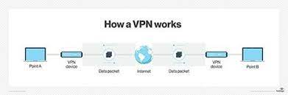
A VPN’s Purpose
Living in today’s digital world means opening yourself up to a whole new list of online threats, on your personal devices and at work. VPNs fight for your privacy and secure your device connections. They’re essential to your online safety

Slide 5
what a virtual private network (VPN) does?
VPN secure your network traffic and add to your online privacy. They encrypt the data going from your devices to the internet and reroute your connection through a private server, which also changes your IP address. That’s a nifty feature because it’ll hide your location and make it look like you’re accessing the web from the VPN server’s address.

Slide 6
Features of VPN
Security
Reliability
Scalability

Slide 7
Types of VPN
Public VPN
Remote Access VPN
Site-to-Site VPN

Slide 8

Public VPN
Public VPN is a type of VPN connection that can be accessed publicly or openly by end users.
It differs from standard or private VPN, which is generally reserved for specific users, organizations or subscribers.
It is normally accessed using a standard Internet connection.

Slide 9
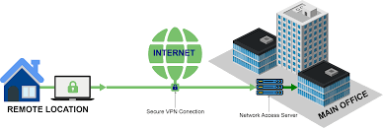
Remote Access VPN
Remote access VPN allows a user to connect to a private network and access its services and resources remotely.
The connection between the user and the private network happens through the Internet and the connection is secure and private.
Remote Access VPN is useful for business users as well as home users.

Slide 10
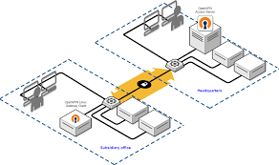
Site-to-Site VPN
A Site-to-Site VPN is also called as Router-to-Router VPN and is mostly used in the corporates.
Companies, with offices in different geographical locations, use Site-to-site VPN to connect the network of one office location to the network at another office location.

Slide 11
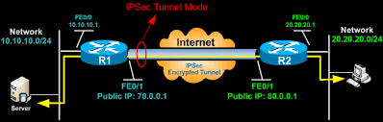
Working of VPN
It creates a tunnel between the network.
A VPN tunnel is an encrypted link between your computer or mobile device and an outside network.
A VPN tunnel connects your smartphone, laptop, computer, or tablet to another network in which your IP address is hidden and all the data you generate while surfing the web is encrypted.

Slide 12
Equipment used for VPN
Network access server
Firewall
AAA Server
VPN Concentrator
VPN-enabled/VPN-optimized Router
VPN-enabled Firewall
VPN Client

Slide 13
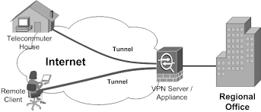
Network access server
As previously described, a NAS is responsible for setting up and maintaining each tunnel in a remote-access VPN.
As previously described, a NAS is responsible for setting up and maintaining each tunnel in a remote-access VPN.

Slide 14

Firewall
A firewall provides a strong barrier between your private network and the Internet.
IT staff can set firewalls to restrict what type of traffic can pass through from the Internet onto a LAN, and on what TCP and UDP ports. Even without a VPN, a LAN should include a firewall to help protect against malicious Internet traffic. Image Source:

Slide 15
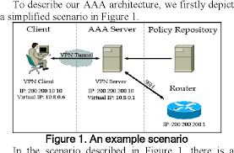
AAA Server
The acronym stands for the server's three responsibilities: authentication, authorization and accounting.
For each VPN connection, the AAA server confirms who you are (authentication), identifies what you're allowed to access over the connection (authorization) and tracks what you do while you're logged in (accounting).

Slide 16
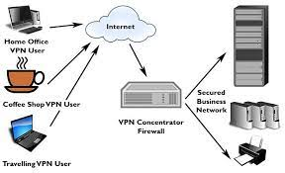
VPN Concentrator
This device replaces an AAA server installed on a generic server.
The hardware and software work together to establish VPN tunnels and handle large numbers of simultaneous connections.

Slide 17

VPN-enabled/VPN-optimized Router
VPN-enabled/VPN-optimized Router.
This is a typical router that delegates traffic on a network, but with the added feature of routing traffic using protocols specific to VPNs.

Slide 18
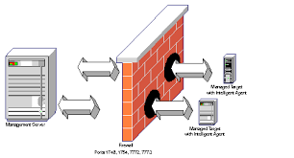
VPN-enabled Firewall
This is a conventional firewall protecting traffic between networks, but with the added feature of managing traffic using protocols specific to VPNs.

Slide 19
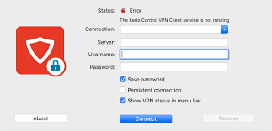
VPN Client
This is software running on a dedicated device that acts as the tunnel interface for multiple connections.
This setup spares each computer from having to run its own VPN client software.

Slide 20
VPN Security
L2F (Layer 2 Forwarding)
PPTP (Point-to-Point Tunneling Protocol)
L2TP (Layer 2 Tunneling Protocol

Slide 21
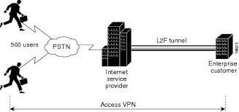
L2F (Layer 2 Forwarding)
L2F (Layer 2 Forwarding) developed by Cisco; uses any authentication scheme supported by PPP.
To create a Private network over internet

Slide 22
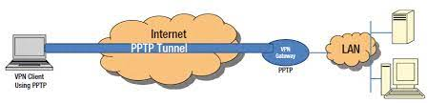
PPTP (Point-to-Point Tunnel Protocol)
PPTP (Point-to-point Tunnel Protocol) supports 40-bit and 128-bit encryption and any authentication scheme supported by PPP.
To make Network connections between Public network

Slide 23
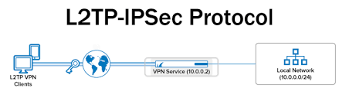
L2TP (Layer 2 Tunnel Protocol)
L2TP (Layer 2 Tunnel Protocol) combines features of PPTP and L2F and fully supports IPSec; also applicable in site-to-site VPN.
Delivery of services by ISPs.

Slide 24
Advantages of VPN
Hides your private information
Escape data-throttling
Avoid bandwidth-throttling
Access region-blocked services like PUBG Mobile
Avoid censorship when travelling abroad
Access regional sports coverage unavailable in your location
Offer cheaper leased-line alternatives.

Slide 25
Disadvantages of VPN
With some VPNs, your connection can be slower.
Certain websites block VPN users.
VPNs are illegal or questionable in certain countries.
There's no way of knowing how well a VPN encrypts your data.
Some VPNs log and sell browsing data to third parties.

Slide 26
DHCP & DNS Service

Slide 27
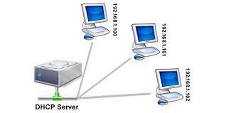
DHCP Service
Introduction
Dynamic Host Configuration Protocol (DHCP) is a network management protocol used to dynamically assign an Internet Protocol (IP) address to any device, or node, on a network so they can communicate using IP.
The DHCP client will demand an IP address by broadcasting a DHCP Discover message to the local subnet.

Slide 28
DHCP Process
1. DHCP DISCOVER: The client broadcasts a request for a DHCP server. 2. DHCP OFFER: DHCP servers on the network offer an address to the client.
3. DHCP REQUEST: The client broadcasts a request to lease an address from one of the offering DHCP servers.
4. DHCP ACKNOWLEDGEMENT: The DHCP server that the client responds to acknowledges the client, assigns it any configured DHCP options, and updates its DHCP database. The client then initializes and binds its TCP/IP protocol stack and can begin network communication.

Slide 29
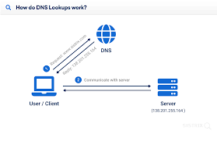
DNS Service
Introduction
Domain Name System (DNS) is an Internet service that translates the domain names into IP addresses, which computer can understand.
Every device connected to the internet has a unique IP address which other machines use to find the device.

Slide 30
There are 4 DNS servers involved in loading a webpage:
1.DNS recursor - The DNS recursor is a server designed to receive queries from client machines through applications such as web browsers.
2.Root name server - The root server is the first step in translating (resolving) human readable host names into IP addresses
3.TLD name server - The top level domain server (TLD) ,This name server is the next step in the search for a specific IP address, and it hosts the last portion of a hostname (In example.com, the TLD server is “com”).
4. Authoritative name server - If the authoritative name server has access to the requested record, it will return the IP address for the requested hostname back to the DNS Recursor (the librarian) that made the initial request.

Slide 31
HTTP & HTTPS

Slide 32
Hypertext Transfer Protocol (HTTP)
Introduction
HTTP is a communication protocol. It defines mechanism for communication between browser and the web server.
HTTP request comprises of lines which contains: ○ Request line ○ Header Fields

Slide 33
Key Points
The first line i.e. the Request line specifies the request method i.e. Get or Post.
The second line specifies the header which indicates the domain name of the server from where index.htm is retrieved.
HTTP Response ○ Like HTTP request, HTTP response also has certain structure. HTTP response contains: ○ Status line ○ Headers
Message body

Slide 34
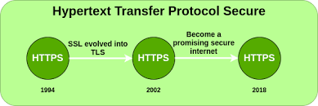
Hypertext Transfer Protocol Secure (HTTPS)
Introduction
Hypertext Transfer Protocol Secure (HTTPS) is an extension of the Hypertext Transfer Protocol (HTTP). It is used for secure communication over a computer network and is widely used on the Internet.
In HTTPS, the communication protocol is encrypted using Transport Layer Security (TLS) or, formerly, Secure Sockets Layer (SSL).

Slide 35
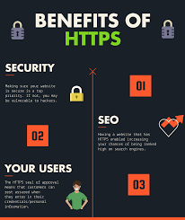
Advantages
User Data is Encrypted
You’ll Enjoy Better SEO (search engine optimisation)
Protects your website from Phishing

Slide 36
Limitations
SSL/TLS does not prevent the indexing of the site by a web crawler
SSL (Secure Sockets Layer) and TLS (Transport Layer Security) encryption can be configured in two modes: simple and mutual

Slide 37
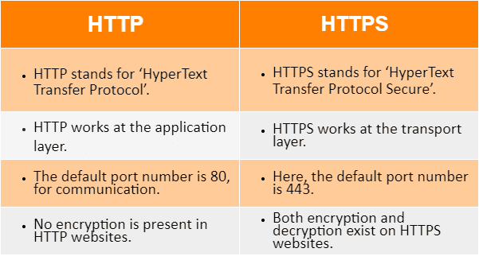
Difference Between HTTP & HTTPS

Slide 38
Conclusion:
We had Discussed about the following topics:
1. VPN
Introduction
Features
Types of VPN
VPN Securities
2. DHCP & DNS Services
Introduction
Key Points
3. HTTP &HTTPS
Introduction
Advantages & Disadvantages
Difference Between HTTP & HTTPS

Slide 39
Thank You

